Slide 1
Pathwise coordinate optimization
Michał Gromadzki

Slide 2
Coordinate Descent – key points
Used to solve lasso regression
Iterative method
Loops through parameters
Optimizes one coordinate at a time
Keeps all other coordinates frozen
Effective for problems with sparse solutions
Proposed in 2007

Slide 3
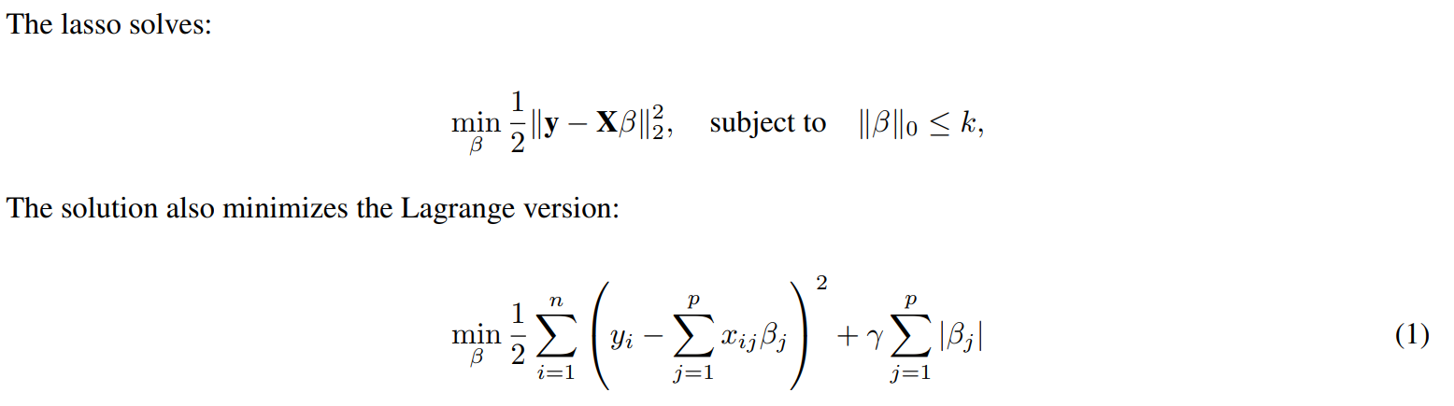
Lasso Regression

Slide 4
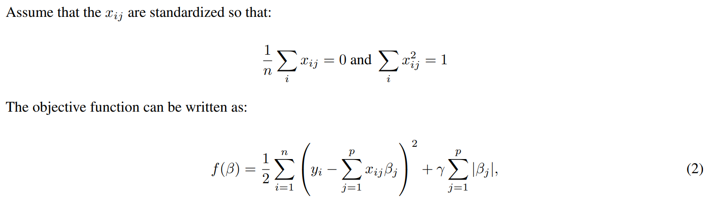
Derivation

Slide 5
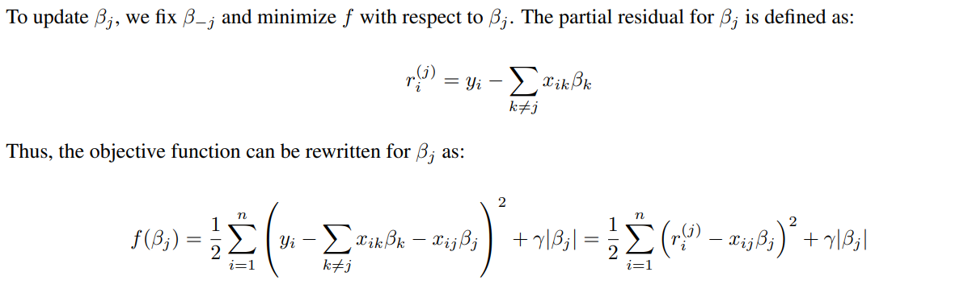
Derivation

Slide 6
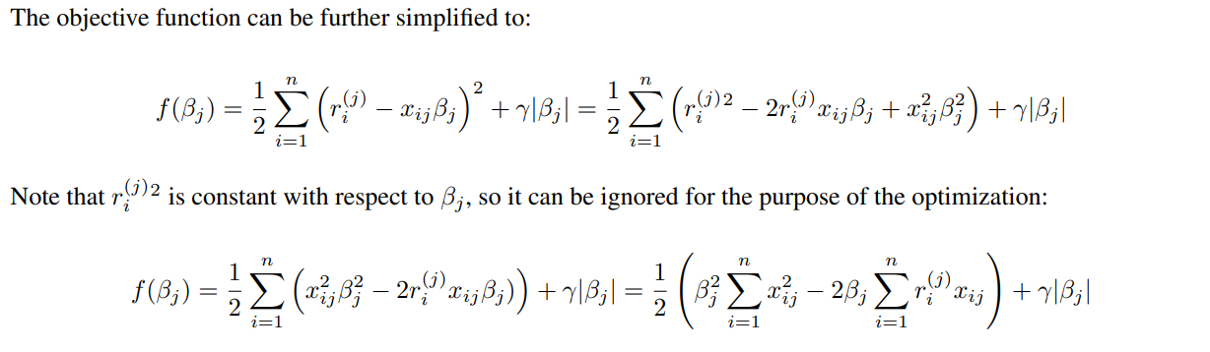
Derivation

Slide 7
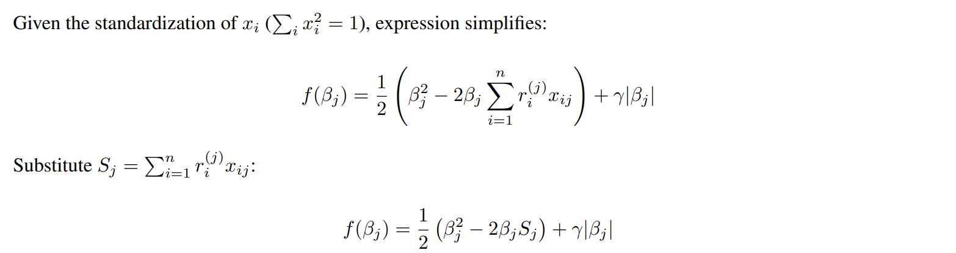
Derivation

Slide 8
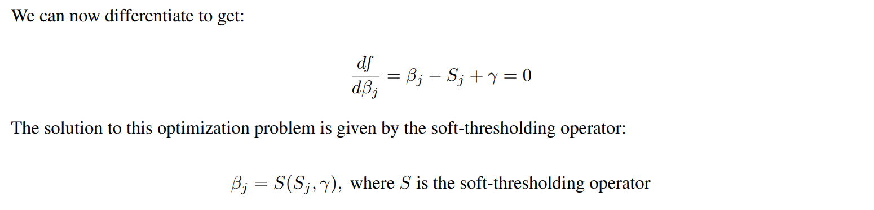
Derivation

Slide 9
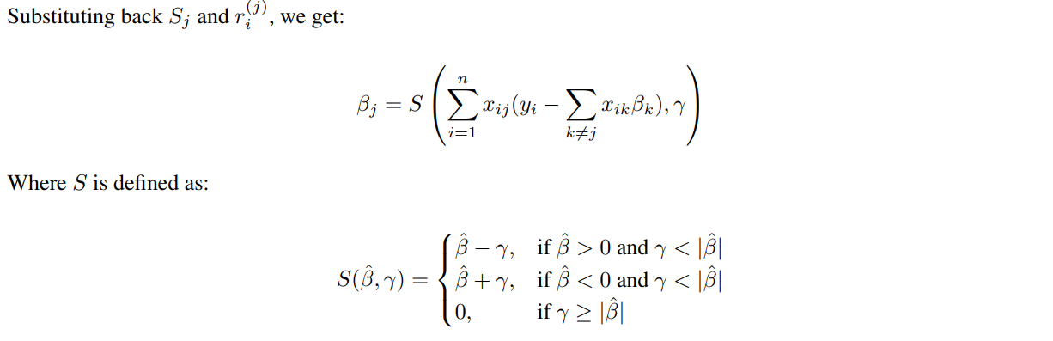
Derivation

Slide 10
Implementation
The Pathwise Coordinate algorithm has been implemented as a class in Python.
Attributes:
lam (float) - The regularization parameter
tol (float)- The tolerance level for convergence
max_iter (int) - Maximum number of iterations of the algorithm
weights (array) – The parameters for the regression
Methods:
fit() – This method uses the Pathwise Coordinate optimization algorithm to fit the regression model to the data
predict() - Predicts the output for given input data X using the learned weights
get_params() - This method returns the learned parameters and the regularization parameter

Slide 11

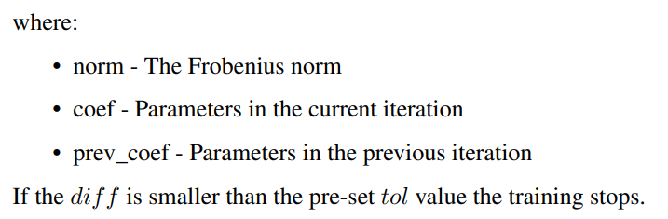

Stopping rule
At the end of each iteration of the algorithms the following value is computed.

Slide 12


Modification
In the modified version instead of iterating through columns from 1 to p. In each iteration, the order is randomly selected. This approach aims to introduce an element of randomness that can potentially improve the convergence properties of the algorithm and avoid cycles that might occur when using a fixed order.

Slide 13
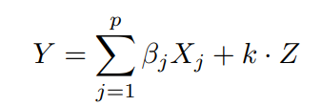
Experiments - data
Gaussian data was generated with n observations and p predictors, with each pair of predictors X_i , X_j having the same population correlation ρ. The outcome values were generated by:

Slide 14
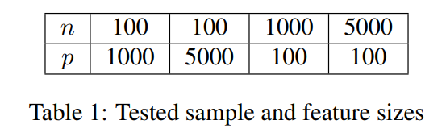
Experiments
3 algorithms:
Coordinate descent
Coordinate descent – modification
LassoLars – sklearn
6 values of ρ: 0, 0.1, 0.2, 0.5, 0.9, 0.95
Each experiment computed 15 times

Slide 15
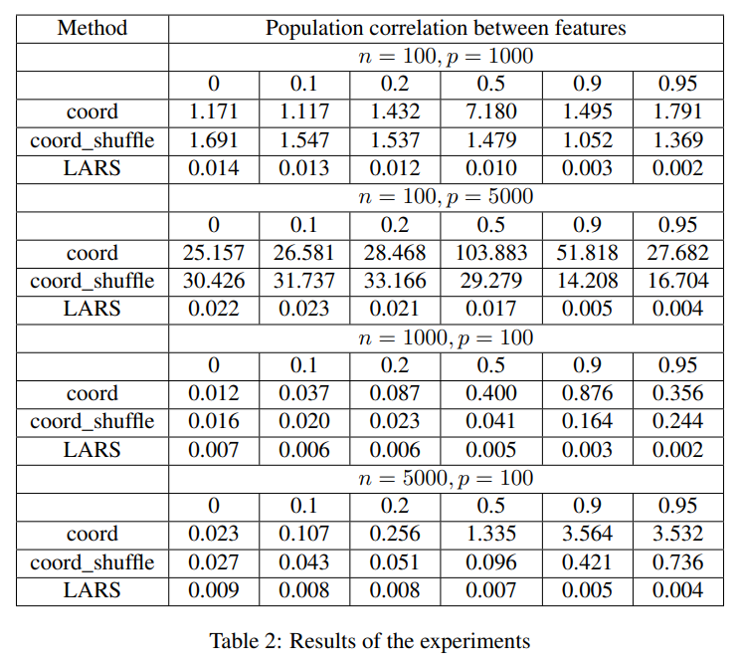
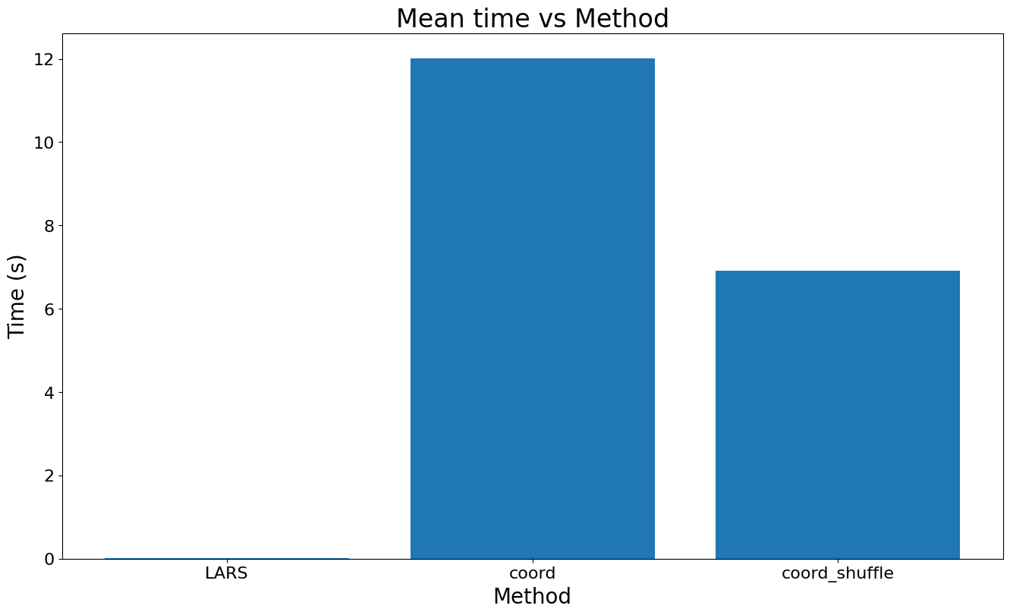
Results

Slide 16
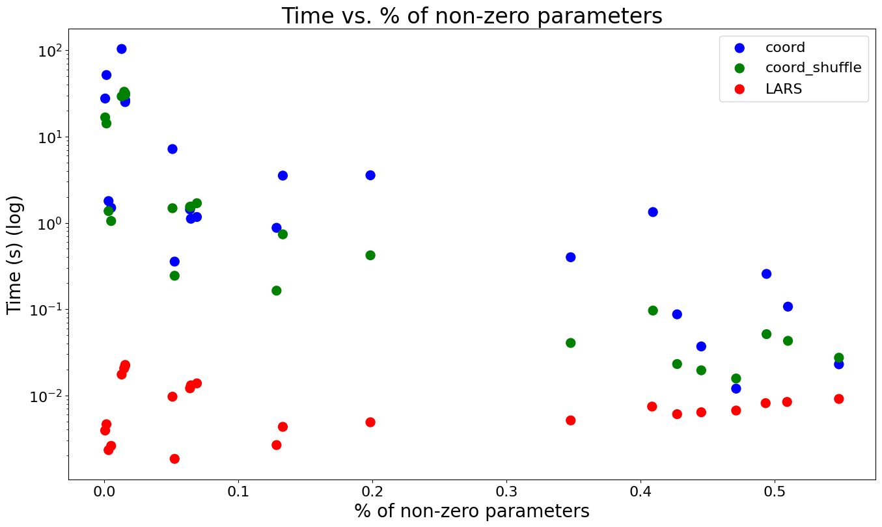
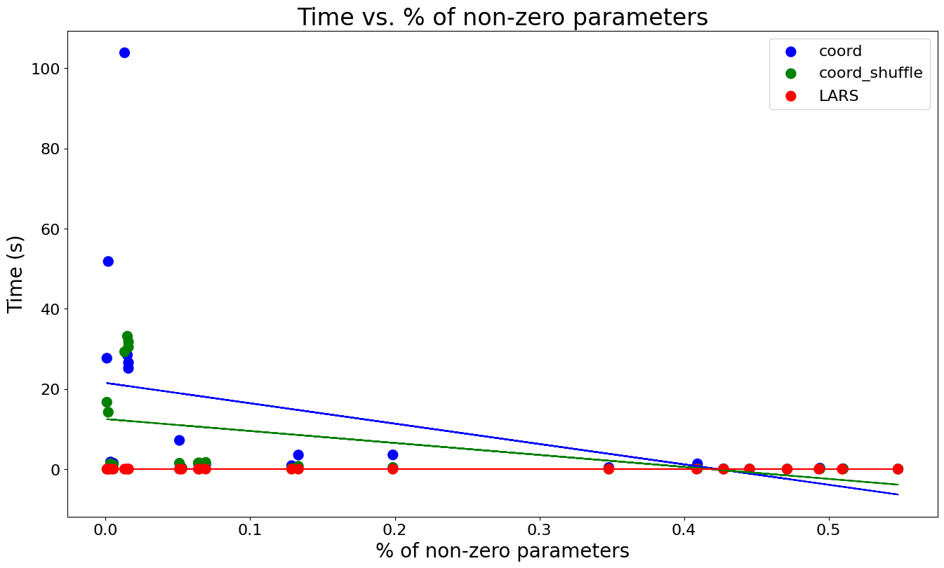
Results

Slide 17
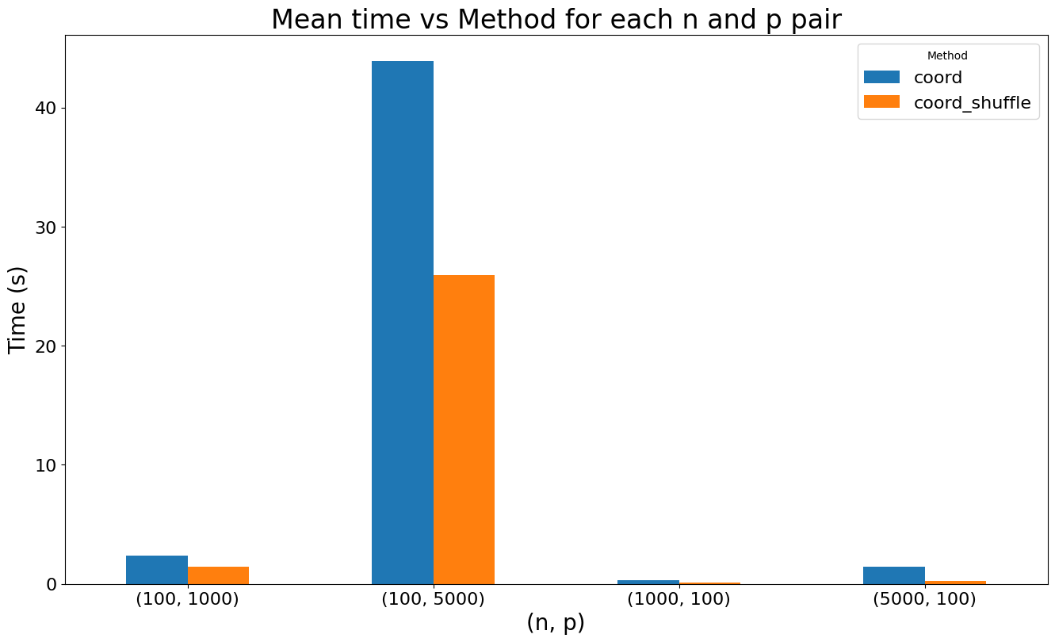
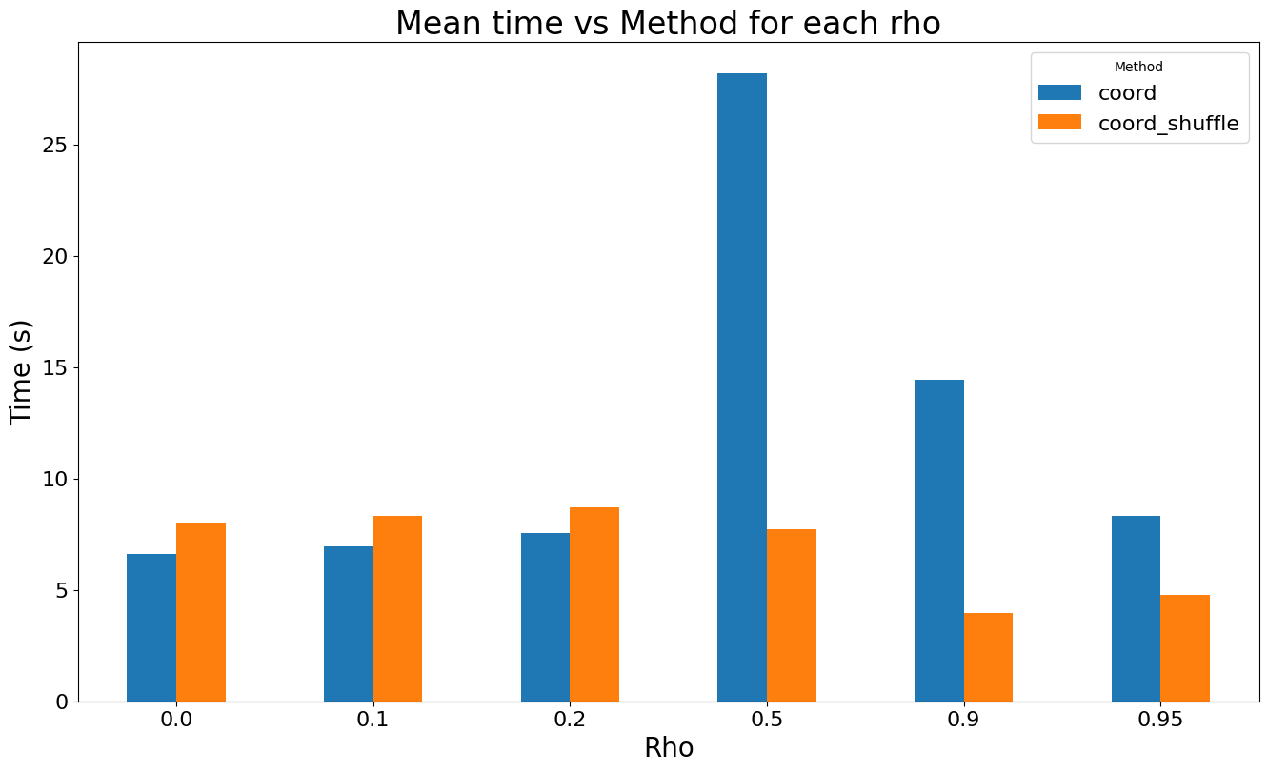
Results

Slide 18
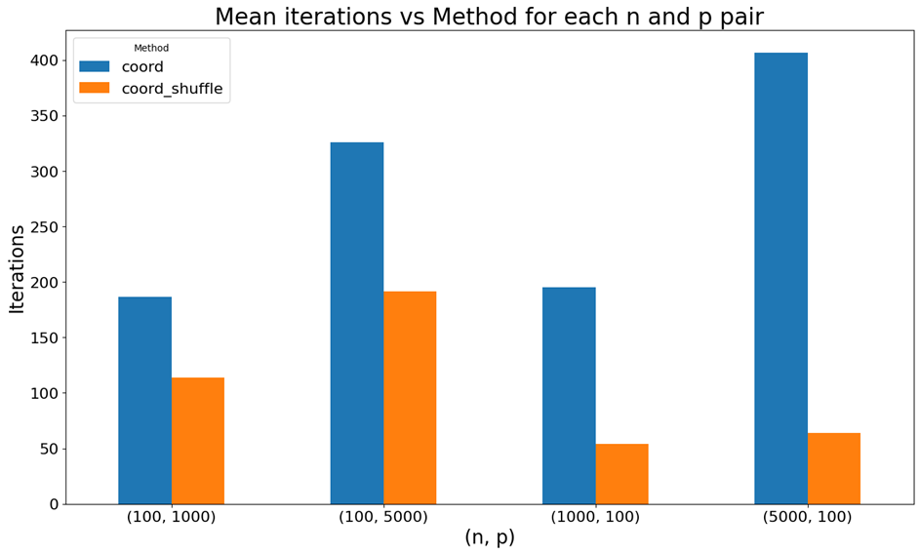
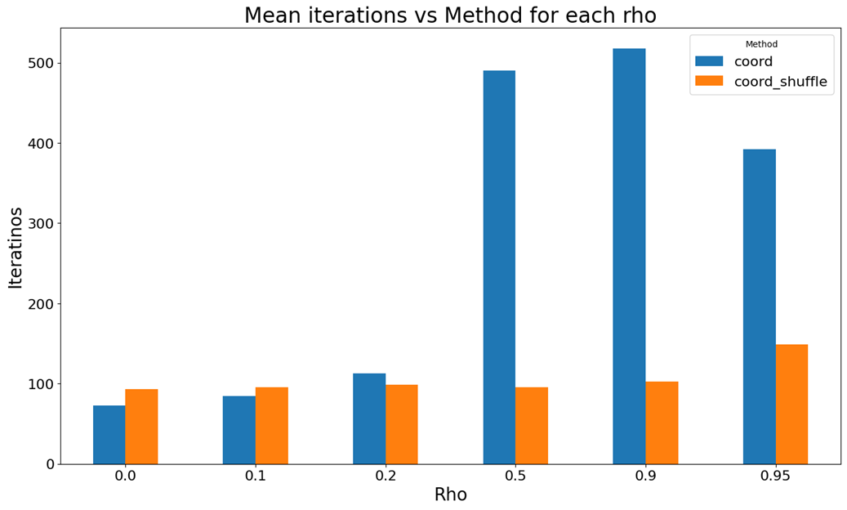
Results

Slide 19
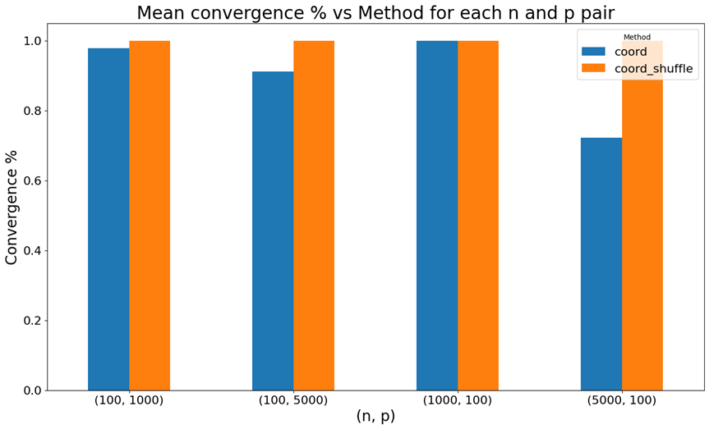
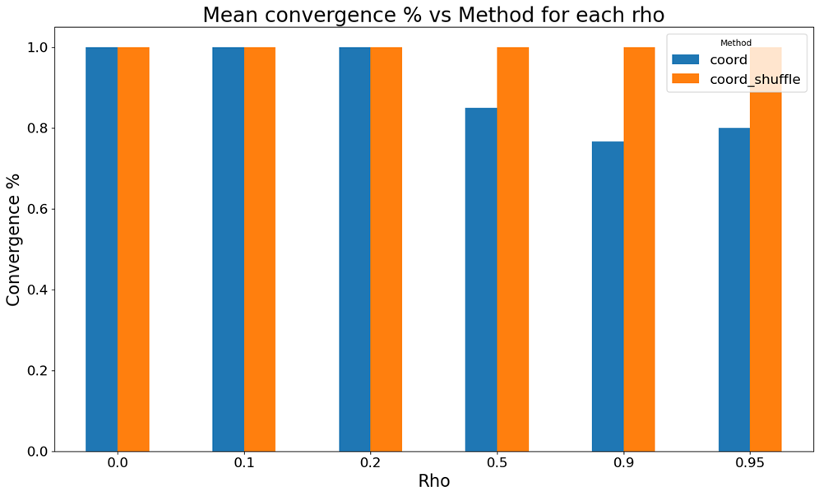
Results

Slide 20
Conclusion
It is impossible to compare times because of implementations in different languages
Modified coordinate descent outperforms the original version in most cases
The higher the % of non-zero parameters the lower the execution time
The number of features has a much bigger impact on execution times than the number of samples
LARS execution time decreases with increasing ρ

Slide 21
Refrences
Friedman et al, The Annals of Applied Statistics, Vol. 1, 2007, pp. 302322
Least Angle Regression; Bradley Efron, Trevor Hastie, Iain Johnstone, Robert Tibshirani

